Slide 1

ROCKBUSTER stealth
DATA ANALYSIS PROJECT
By Javier Sanchez-Agesta Sancbez

Slide 2

ROCKBUSTER STEALTH LLC
Rockbuster Stealth LLC is a movie rental company that used to have stores around the world.
the Rockbuster Stealth management team is planning to use its existing movie licenses to launch an online video rental service in order to stay competitive AGAINST INDUSTRY GIANTS LIKE NETFLIX OR AMAZON PRIME .

Slide 3
Key questions and objectives
Which movies contributed the most/least to revenue gain?
What was the average rental duration for all videos?
Which countries are Rockbuster customers based in?
Where are customers with a high lifetime value based?
Do sales figures vary between geographic regions?

Slide 4




ROCKBUSTER DATA SUMMARY
MOVIE LENGTH (MINUTES)
MIN 46
AVG 115.27
MAX 185
RENTAL DURATION (DAYS)
MIN 3
AVG 4.99
MAX 7
RENTAL RATE (dollars)
MIN 0.99
AVG 2.98
MAX 4.99
Replacement cost (Dollars)
Min 9.99
Avg 19.99
Max 29.99

Slide 5

Which movies contributed the most/least to revenue gain?

Slide 6
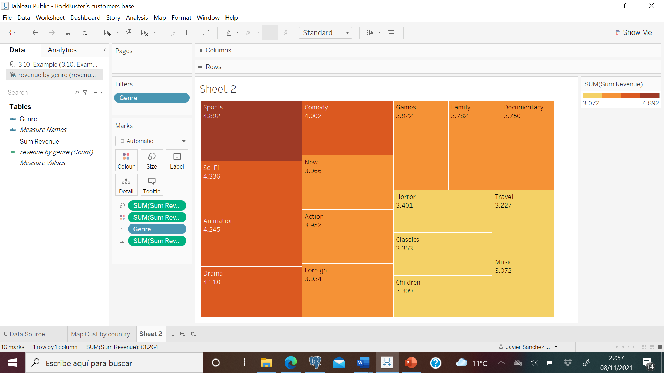

Revenue by Genre
The Sports Movies are the leaders in terms of revenue.
Sci-Fi, Animation, Drama and Comedy follow on the list.
The movies generating less revenue are Music, Travel and Children.
Thrillers generated under $48 and it is not represented in the treemap.

Slide 7
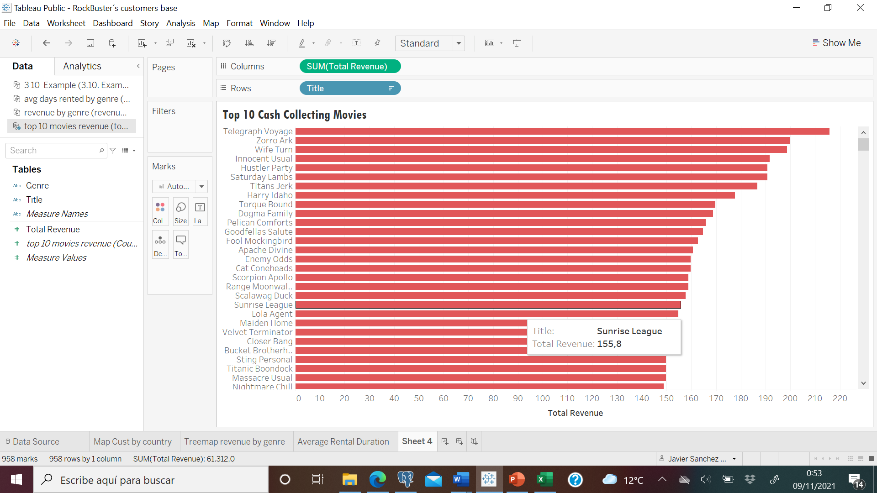
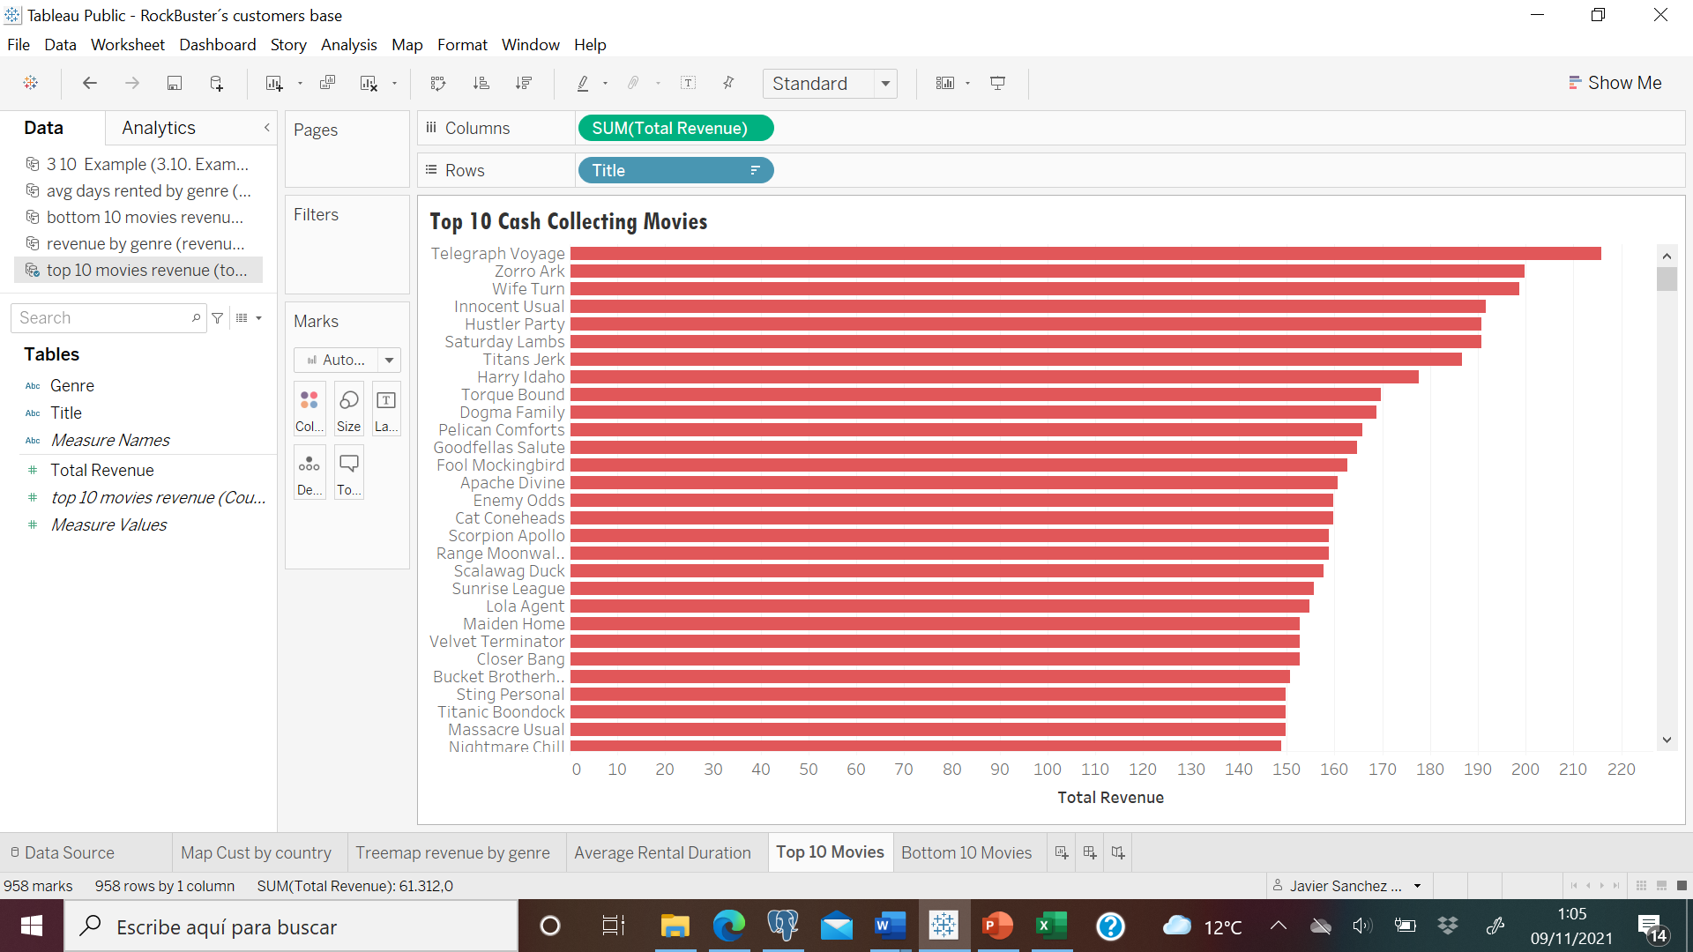
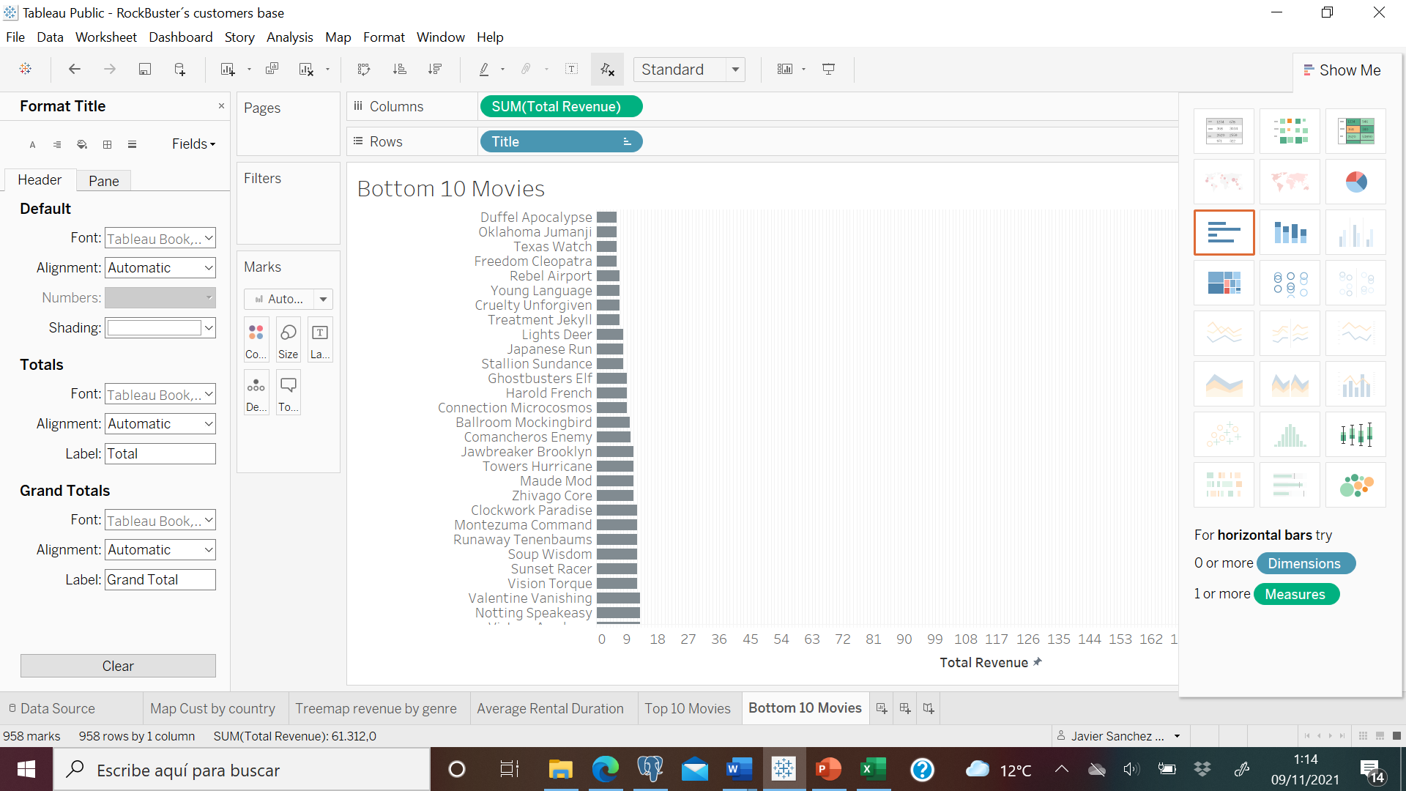
Top 10 cash making movies
Rockbuster´s Hall of Fame
The graphs represent the number of revenue made by the movies expressed in $ (Dollars).
Top 10 movies to be promoted within the web.
Bottom 10 movies looking forward to license termination
BOTTOM 10 moNEY MAKERS
Rockbuster´s Hall of Shame

Slide 8

What was the average rental duration for all videos?

Slide 9
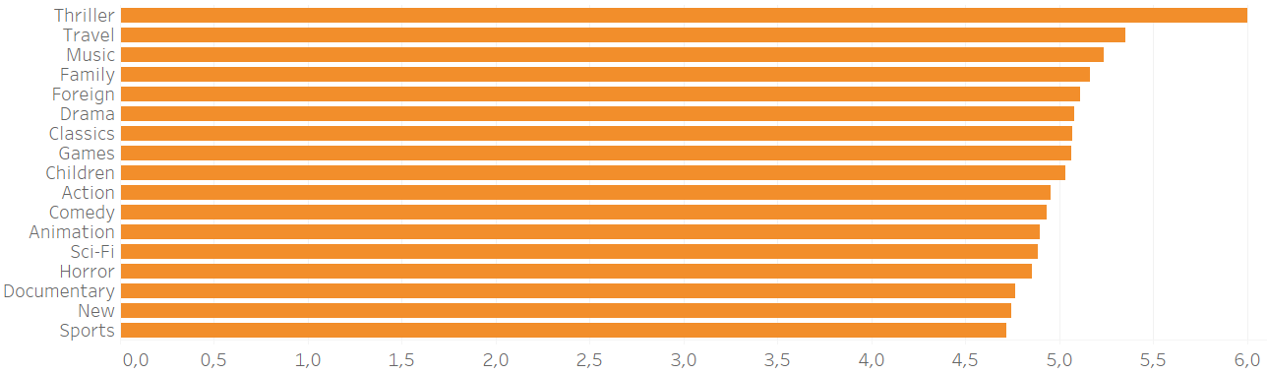
AVERAGE DAYS RENTED
The average number of days the movies are rented doesn´t vary too much between different genres.
Curiosly enough, the movies generating less income are in average more time rented, and leader in revenue Sports is at the bottom of our list.

Slide 10

Which countries are Rockbuster customers based in?

Slide 11
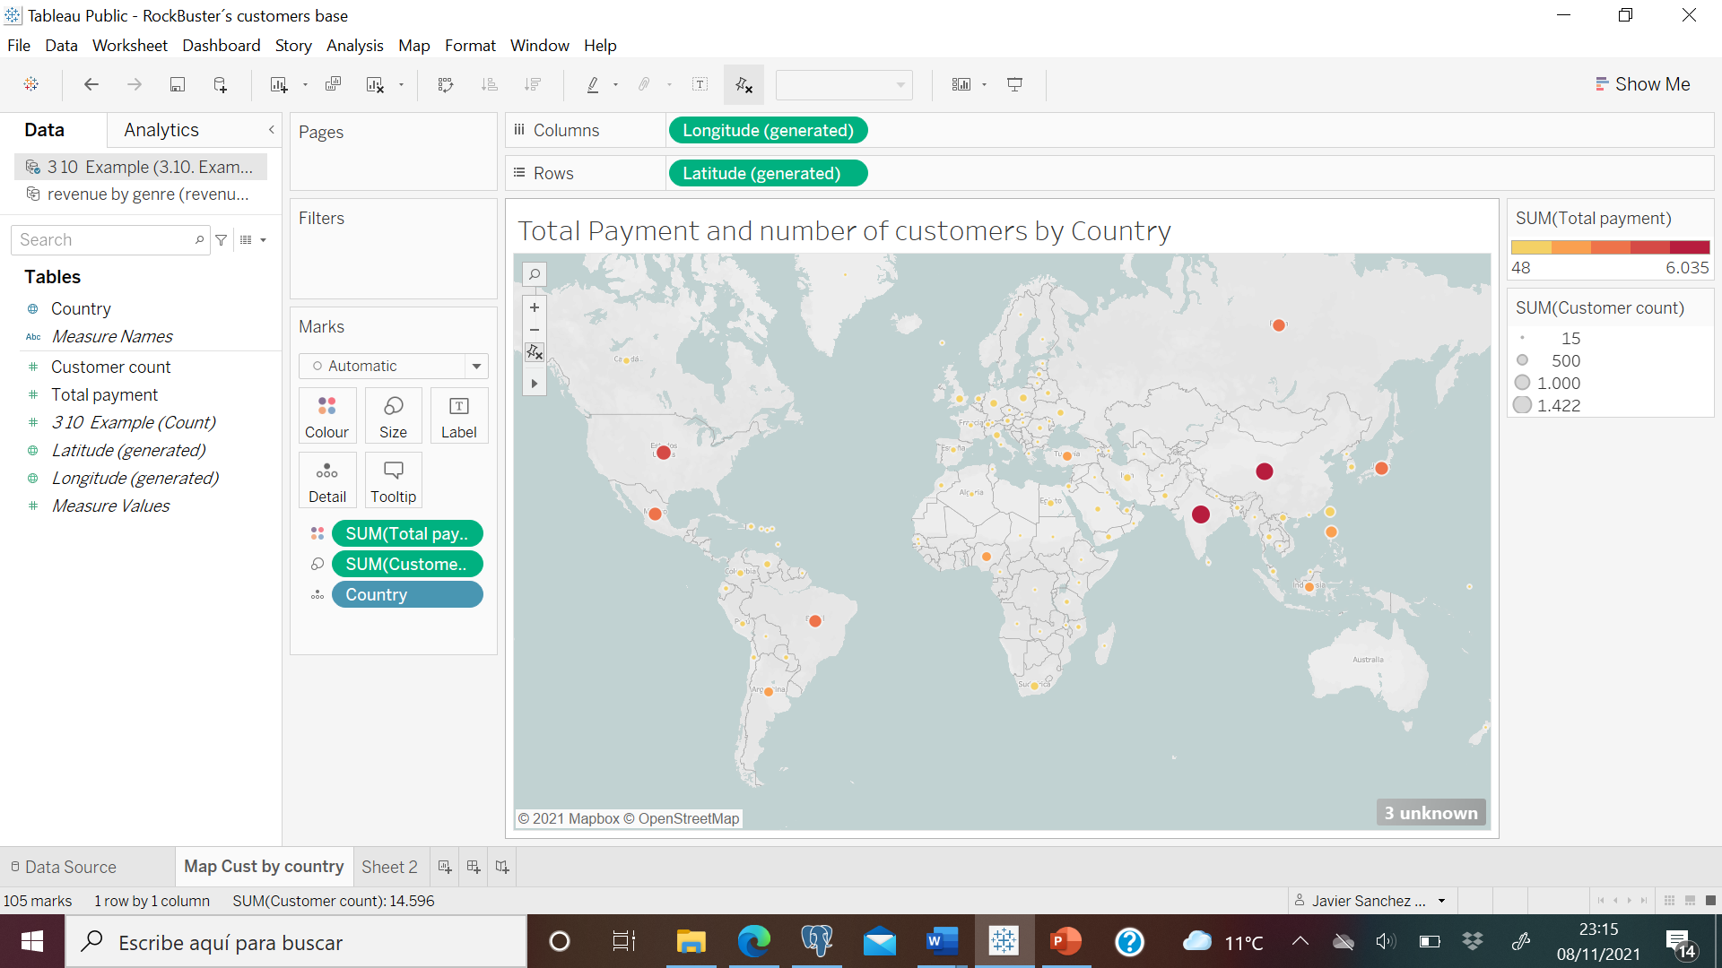
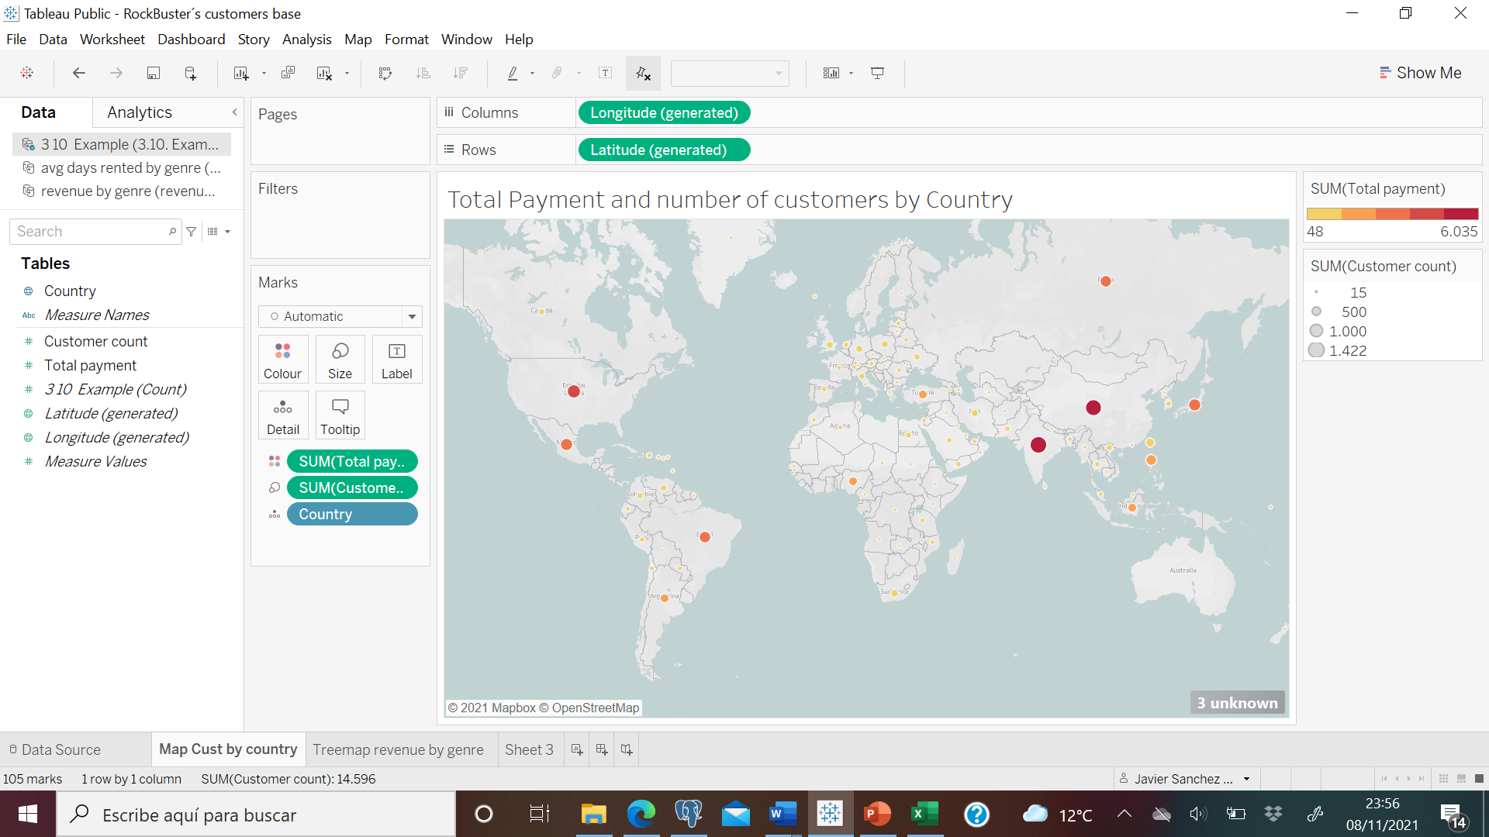
Rockbuster has its customers all spread around the world.
China, India, United States, Japan and Mexico are the countries with a bigger customer base, although still tiny compared to main competitors.
Revenue per country
Number of customers

Slide 12

Do sales figures vary between geographic regions?

Slide 13
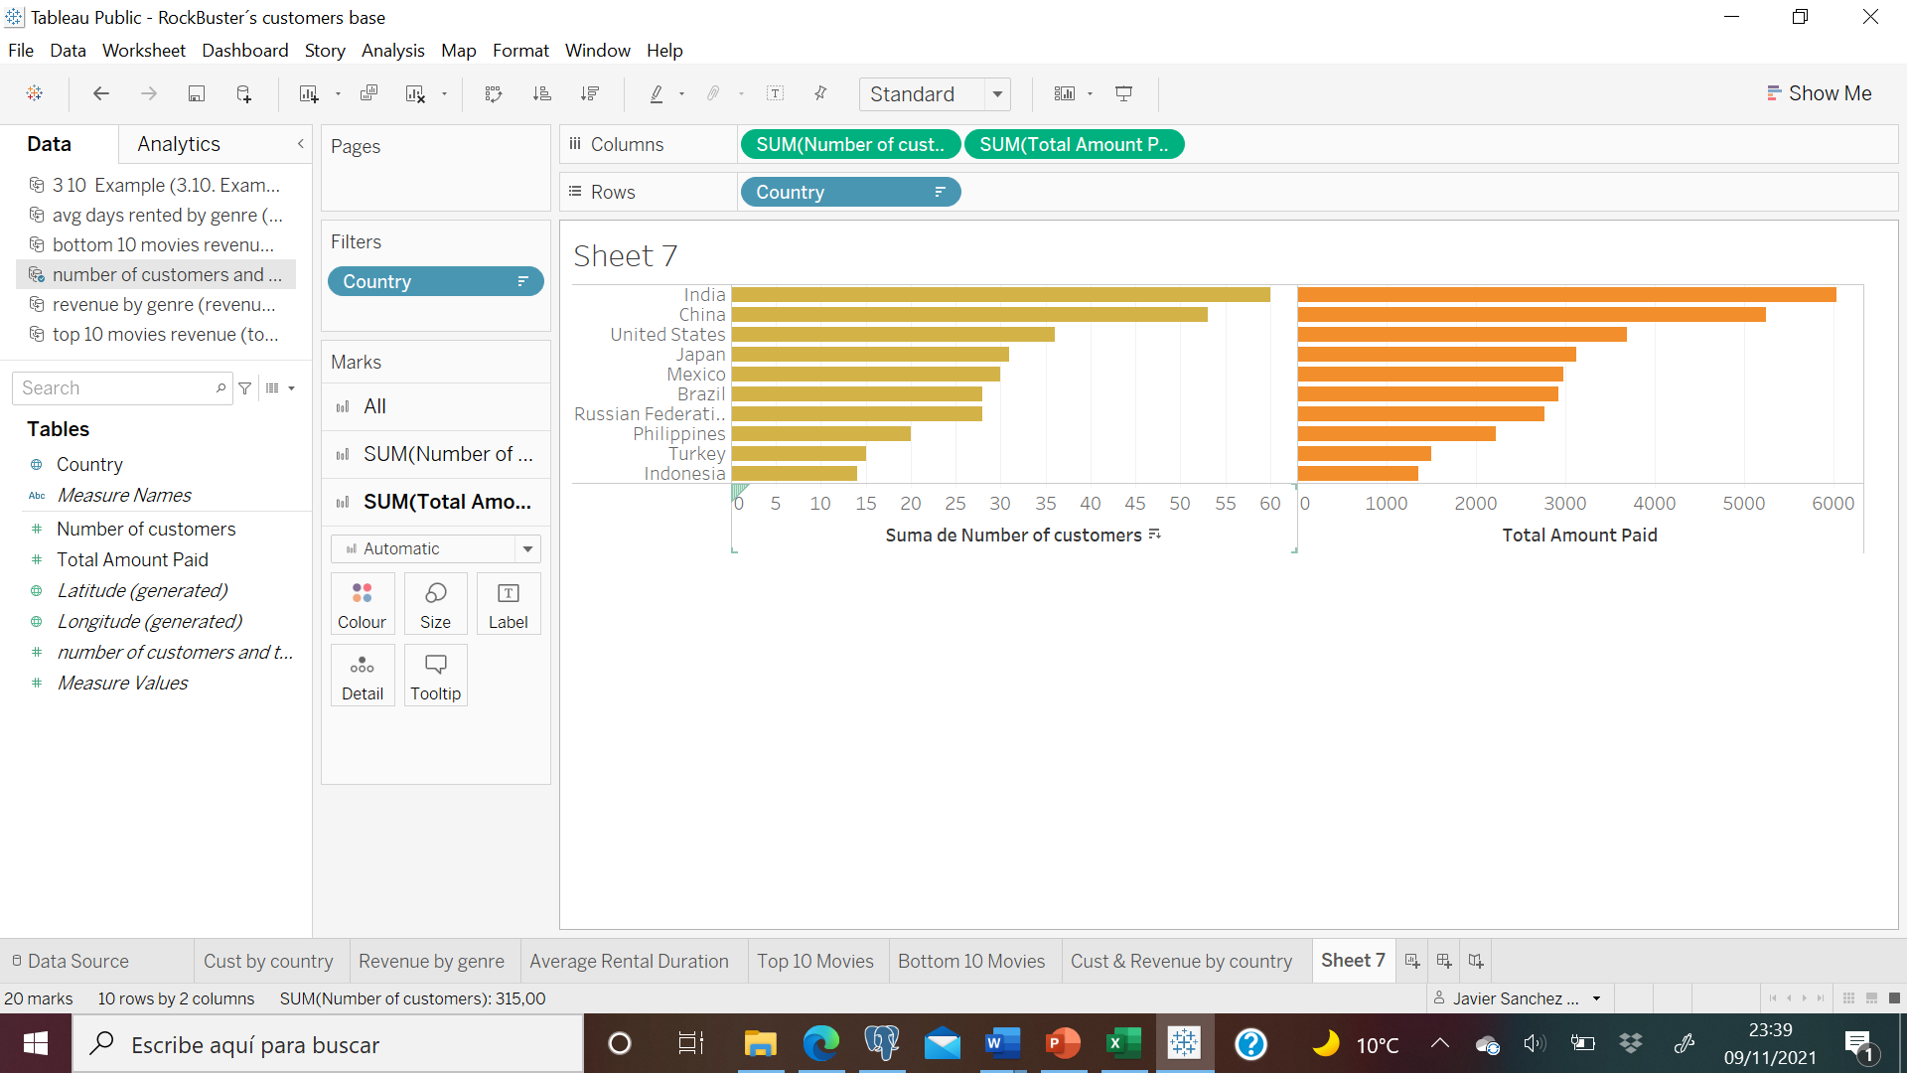
Number of customers
As we can see, the number of customers and regional sales graphs are very similarly shaped.
This means that there is no difference regarding to sales between the different geographic regions.
More customers = … more sales
Regional Sales ( $ )

Slide 14
Where are customers with a high lifetime value based?

Slide 15
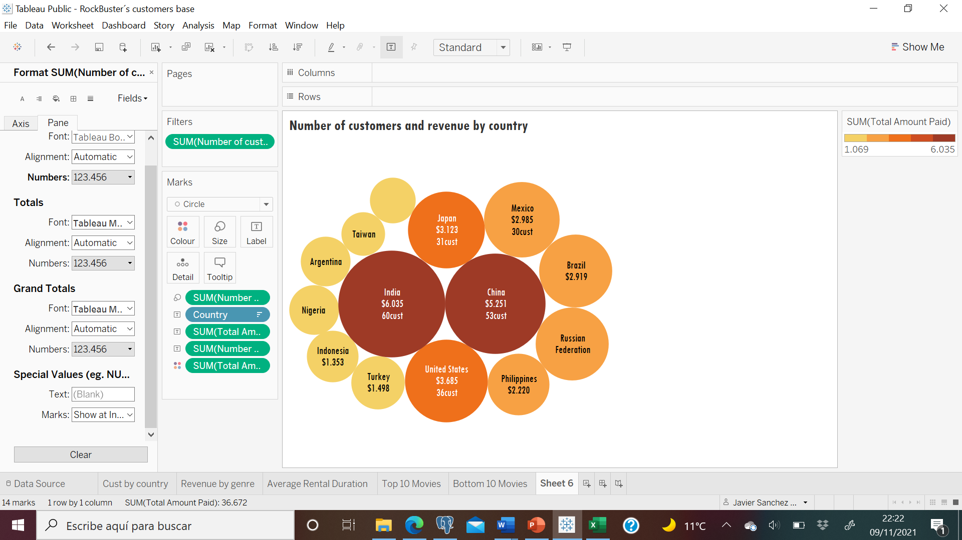
Rockbuster´s main revenue comes from
Total amount paid ($)
Top 5
India, china, u.s.a, Japan & mexico
Rockbuster has performed well thanks to their loyal customers. In order to keep expanding, marketing teams have designed a promotion to reward loyalty.

Slide 16


Rockbuster has analysed the total sales per customer… And the winner is… ( are )
The winners will receive a code to actívate 3 movies of their choice for a period of one week each.
They will also receive one of our famous “Best Customer” Roscars statues.
As an extra, they can get one more free movie if they share a picture with their award on
Karl seal ( U.s.a ) $208.58
Maryon snyder ( brazil ) $194.61
Ana bradley ( U.s.a ) $167.67
Marcia dean ( philippines ) $166.61
Mike way ( india ) $162.67
BEST CUSTOMER
@rockbusteristhemasterpictures

Slide 17
Conclusions & recommendations
The most popular genres within rockbuster´s audience are sports, sci-fi & animation.
Rockbuster should not renew licence for those movies for which the revenue was lower than the replacement cost.
Rockbuster should get rid of all the thriller movies as they expire, as they are the least popular within their customers and generated very Little revenue.
The average rental duration is 5 days.
Together with the promotion to reward top customers, i would recommend to make marketing promotions in the top 5 countries.

Slide 18

Thank you for watching
Click here to Access to Tableau link
Analysis by Javier sanchez agesta

